Slide 1

Working with the Reservoir DDMS
Lab Module 8

Slide 2
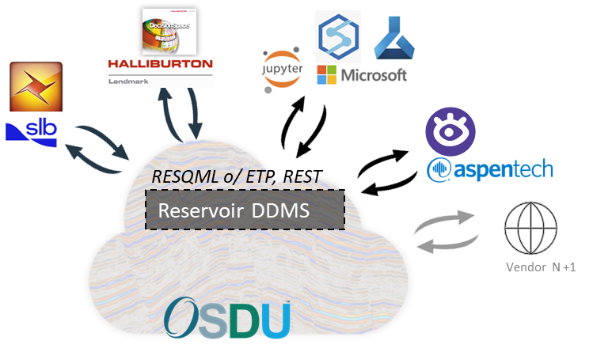
Reservoir DDMS in a nutshell
Scope:
Scope/domain: Seismic interpretation, geomodelling, reservoir simulation
Storage, optimized query and consumption of data based on metadata, relationships, and properties.
Support System of record and System of Interaction
Current data types:
Types defined by OSDU Data Definition
conceptual objects, interpretations (strat. columns, well markers, horizons, faults, frameworks, …),
their representations (pointsets, curves, various 2D and 3D grids), and their associated
properties (arrays of continuous, discrete and categorical values)
Content data model:
RESQML 2.0.1 (2.2),
WITSML 2.0, PRODML 2.0 where they complement RESQML
Ingestion and consumption via files (RESQML.epc), or ETP API, or REST API
OSDU core service integration on ADME (auth, indexing) planned for next release M18
Public gitlab resources: Reservoir DDMS

Slide 3
Reservoir DDMS: ingestion and consumption stories
Data Ingestion
Direct ETP ingestion for metadata and binary data of complete or partial objects
Ingest RESQML files (Epc+H5), send content to ETP server, manifest to DocumentDB
Data Consumption
Domain specific queries capabilities through ETP discovery, and object search:
Using data models, multi-level relationship, numerical properties for query
Use Multi-DDMS/CSS requests
Allow retrieval of partial datasets, slicing of binary data
Direct retrieval of both metadata and binary data using direct ETP connection or REST API
Supports granularity of all objects in a model, collections of objects and their dependencies, individual objects, individual arrays of binary data, multi-dimensional subarrays of binary data.
Recreation of RESQML files from a list of objects (Targeting legacy software)
Notes:
relationships (topology, whole-part, collections, associations),
properties (user input, calculated and persistent, calculated on the fly)

Slide 4

Reservoir DDMS Architecture overview
REST Client
Ex: Postman
RESERVOIR DDMS
Reservoir store for
1. Meta data: | Data catalog .xml part Object relationships
2. Binary data | Geometries, property values, etc…
Rest Server
Typescript
ETP Server C++
REST
REST Server
ETP Client
RESQML data storage
ETP Client
C++, java, Python, Go ...
ETP
(RESQML)

Slide 5
Document DB and Reservoir DDMS
 | Document DB | Reservoir DDMS
Main responsibility | Search and meta-data across different domains | Full storage of the reservoir domain objects + domain specific search
Storing mechanism | RESQML data file saved in document DB. RESQML files meta data mapped to OSDU meta data definition | Full reservoir model defined in DB tables derived from RESQML data model. No need to have the full Reservoir model defined to save in DDMS
Ingestion mechanism | Workflow-based ingestion (as for WITSML) | API-based
Search mechanism | ES-based | API- based ES- based

Slide 6
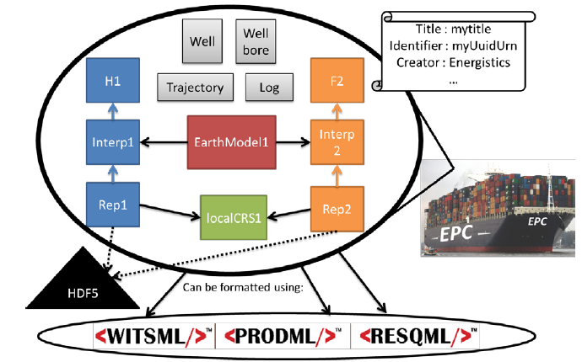
Data Transfer options
Files
1+ EPC zip file, containing XML documents, ref HDF5 file
1+ HDF5 file(s) containing multidimensional array data
Energistics Packaging Convention EPC standard describes the specialization of OPC: organizes XML documents, describes relationships among files
API
ETP
No files needed; uses Avro and Websocket. Fast.
Supports transaction, notification
REST or other APIs (like ODATA on an ETP store)
Use ETP semantics
Can use XML or JSON encoding
ETP Clients:
OSDU ETP Client (donation AspenTech RESQML V2.0.1)
FETPAPI (F2-I Consulting)
WEB Studio RESQML V2.0.1 (Geosiris, TBD)
ETP Servers:
OSDU Reservoir DMS (donation AspenTech, for RESQML V2.0.1 using Postgres)
OSDU External Data Source : Gabbro RESQML V2.0.1 & V2.2 using HSDS and a GraphDB (Geosiris)

Slide 7
Energistics Transfer Protocol (ETP)
ETP is a communication protocol. I.e. precise set of rules for the exchange of data between endpoints, in the form of messages organized into subprotocols.
ETP messages:
Are defined in Avro schemas and serialized using Avro
Are transported in accordance with the message framing of the WebSocket (WS) protocol
Domain resources:
Sometimes, ETP messages transport domain resources such as a well, grid, horizon, perforation, PVT, etc..
Resources are simply transported in an AVRO message byte array field. It contains RESQML or WITSML or PRODML format encoded resource (today in XML, tomorrow possibly in JSON)
ETP advantages over REST. REST issues:
Opening a TCP connection is not free
HTTP Header in each message is not free
Server cannot initiate a send
Server responses must always come in the same order that the requests were received
Other ETP advantages : Binary, Session, Negotiation of optimal message size, compression format,…

Slide 8
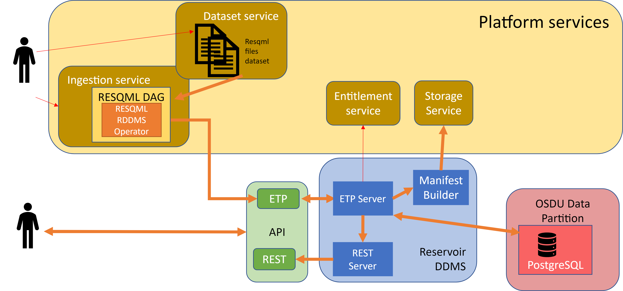
Ingestion

Slide 9
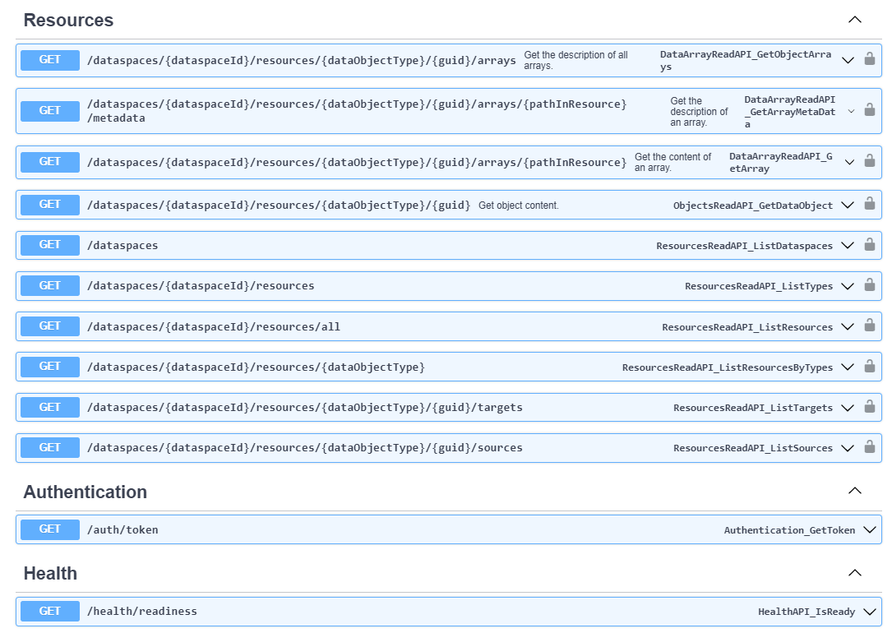
REST API
Wrapper for ETP

Slide 10
Reservoir Meta-data support
1. abstract
1. osdu:wks:AbstractColumnLayerGridPatch:1.0.0
2. osdu:wks:AbstractFacet:1.0.0
3. osdu:wks:AbstractGeologicUnitInterpretation:1.0.0
4. osdu:wks:AbstractGridRepresentation:1.0.0
5. osdu:wks:AbstractIjkGridPatch:1.0.0
6. osdu:wks:AbstractInterpretation:1.0.0
7. osdu:wks:AbstractReferencePropertyType:1.1.0
8. osdu:wks:AbstractRepresentation:1.0.0
9. osdu:wks:AbstractUnstructuredColumnLayerGridPatch:1.0.0
10. osdu:wks:AbstractUnstructuredGridPatch:1.0.0
4. work-product-component
1. osdu:wks:work-product-component--ColumnBasedTable:1.0.0
2. osdu:wks:work-product-component--EarthModelInterpretation:1.0.0
3. osdu:wks:work-product-component--FaultInterpretation:1.0.0
4. osdu:wks:work-product-component--GenericProperty:1.0.0
5. osdu:wks:work-product-component--GenericRepresentation:1.0.0
6. osdu:wks:work-product-component--GeobodyBoundaryInterpretation:1.0.0
7. osdu:wks:work-product-component--GeobodyInterpretation:1.0.0
8. osdu:wks:work-product-component--GeologicUnitOccurrenceInterpretation:1.0.0
9. osdu:wks:work-product-component--GpGridRepresentation:1.0.0
10. osdu:wks:work-product-component--GridConnectionSetRepresentation:1.0.0
11. osdu:wks:work-product-component--HorizonInterpretation:1.0.0
12. osdu:wks:work-product-component--IjkGridRepresentation:1.0.0
13. osdu:wks:work-product-component--LocalBoundaryFeature:1.0.0
14. osdu:wks:work-product-component--LocalModelCompoundCrs:1.0.0
15. osdu:wks:work-product-component--LocalModelFeature:1.0.0
16. osdu:wks:work-product-component--LocalRockVolumeFeature:1.0.0
17. osdu:wks:work-product-component--RockFluidOrganizationInterpretation:1.0.0
18. osdu:wks:work-product-component--RockFluidUnitInterpretation:1.0.0
19. osdu:wks:work-product-component--SealedSurfaceFramework:1.0.0
20. osdu:wks:work-product-component--StratigraphicColumn:1.0.0
21. osdu:wks:work-product-component--StratigraphicColumnRankInterpretation:1.0.0
22. osdu:wks:work-product-component--StratigraphicUnitInterpretation:1.0.0
23. osdu:wks:work-product-component--StructuralOrganizationInterpretation:1.0.0
24. osdu:wks:work-product-component--SubRepresentation:1.0.0
25. osdu:wks:work-product-component--TimeSeries:1.0.0
26. osdu:wks:work-product-component--UnsealedSurfaceFramework:1.0.0
27. osdu:wks:work-product-component--UnstructuredColumnLayerGridRepresentation:1.0.0
28. osdu:wks:work-product-component--UnstructuredGridRepresentation:1.0.0
3. reference-data
1. osdu:wks:reference-data--BoundaryRelationType:1.0.0
2. osdu:wks:reference-data--CellShapeType:1.0.0
3. osdu:wks:reference-data--ColumnBasedTableType:1.0.0
4. osdu:wks:reference-data--ColumnShapeType:1.0.0
5. osdu:wks:reference-data--DepositionGeometryType:1.0.0
6. osdu:wks:reference-data--DomainType:1.0.0
7. osdu:wks:reference-data--FacetRole:1.0.0
8. osdu:wks:reference-data--FacetType:1.0.0
9. osdu:wks:reference-data--FaultThrowType:1.0.0
10. osdu:wks:reference-data--FluidPhaseType:1.0.0
11. osdu:wks:reference-data--GeologicUnitShapeType:1.0.0
12. osdu:wks:reference-data--IndexableElement:1.0.0
13. osdu:wks:reference-data--KDirectionType:1.0.0
14. osdu:wks:reference-data--OrderingCriteriaType:1.0.0
15. osdu:wks:reference-data--PillarShapeType:1.0.0
16. osdu:wks:reference-data--RepresentationRole:1.0.0
17. osdu:wks:reference-data--RepresentationType:1.0.0
18. osdu:wks:reference-data--SequenceStratigraphicSchemaType:1.0.0
19. osdu:wks:reference-data--SequenceStratigraphySurfaceType:1.0.0
20. osdu:wks:reference-data--StratigraphicColumnValidityAreaType:1.0.0
21. osdu:wks:reference-data--ValueChainStatusType:1.0.0

Slide 11
RESQML: characteristics and benefits
Limit information loss/anomalies
The only standard to share reservoir models
Support for scenario & uncertainty
Data relationships: Oriented links indicate how data relate to each other.
Coordinate systems/unit consistency: EPSG & WKT coordinate systems; OSDU-Energistics units of measure
Generic representations allowing separation between domain info & geometry. Extra-meta data
Audit trail: based on Energy Profile of ISO 19115-3:2016
Workflow capture through Activity instance and Activity templates objects
Ease data access/exchange
Separation concept/geometry/property. Accessible/editable independently
Meta-data enables content discovery
Global UUID version + timestamp
Existing API’s
Supported by OSDU Reservoir DDMS as system of record and system of interaction

Slide 12
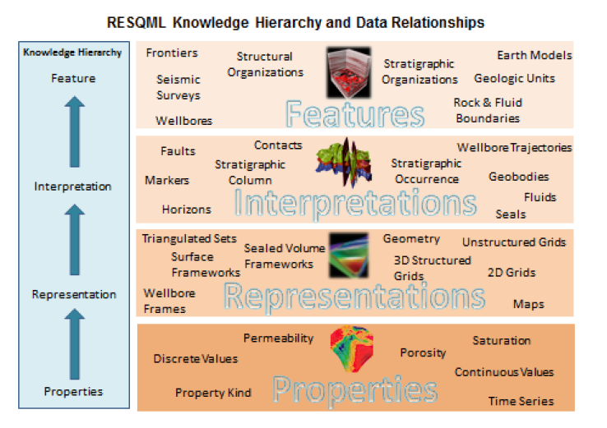
RESQML data model
Hierarchical data model, maintain relationships and semantic hierarchy
Feature: physically exists. Could be Geologic, Technical or earth model organization-related
Interpretation: an “opinion” of a feature
Representation: digital description. Includes topology & geometry. Can be individual objects or related “sets”
Property: value on indexable element of a representation, may be Continuous, Discrete, Categorical, Comment.
Notes:
The feature/interpretation/representation/properties knowledge hierarchy (referred to informally as "FIRP") is a new concept in RESQML; it makes data organization more precise and data exchange more efficient. To establish a “knowledge hierarchy,” asset team members specify relationships between instances of data objects using a RESMQL mechanism called a data object reference (DOR

Slide 13
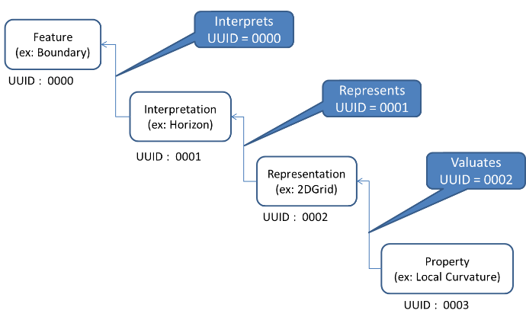
Object reference and multiple interpretations
Implementation of relationships:
Feature
Interpretation
Representation
Property
Representations can be associated with Interpretation
Identification and traceability
UUID and Energy Industry Profile (EIP) metadata, part of OSDU SRN
“Content” of objects/ “Partial-model” transfer
Interpretation
(ex. Another Horizon)
UUID : 1001
Representation
(ex: Points)
UUID : 2002
Property
(ex: Transmissibility)
UUID : 1003
Notes:
example (beginning at the left), the feature (UUID 0000) has 2 interpretations (UUIDs 0001 and 1001); interpretation 0001 has 2 representations (UUIDs 0002 and 1002), and representation 0002 has 2 properties (UUIDs 0003 and 1003).
Object-relationship in XML
Use of object references
Objects must be uniquely identified
Designate relationships between the objects
Group together related objects as collections, "package"

Slide 14
Developing for RESQML - Resources
Open source libraries
OSDU Reservoir DDMS client (C++ or TypeScript; by AspenTech)
FESAPI (RESQML 2.0.1, 2.2) FETPAPI (ETP 1.2, not as mature as FESAPI)
Developed for Windows/Linux/macOS in C++ with SWIG wrappers for: Java, C#, Python
Experimental support Javascript (WebAssembly)
Basic community support forum : FESAPI FETPAPI
resqpy (Python RESQML 2.0.1 parser/classes/utilities; no ETP yet; by BP)
Interaction, support, documentation
OSDU RESQML Workgroup RESQML - General Information and Documents · GitLab (opengroup.org)
OSDU #resqml Slack channel, biweekly forum
RESQML 2.0.1 & 2.2 release; Documentation (release notes, usage guide, tech ref)
Other Open Source tools
WebStudio, Python parser, ETP API, RESQML 2.0.1 & 2.2; by Geosiris)

